Slide 1
AZ-700T00A Module 02: Design and Implement Hybrid Networking

Slide 2
Module Overview
Lesson 01: Design and implement Azure VPN Gateway
Lesson 05: Connect remote resources by using Azure Virtual WANs
Lesson 02: Exercise - Create and configure a Virtual Network Gateway
Lesson 06: Exercise - Create a Virtual WAN by using the Azure Portal
Lesson 03: Connect networks with Site-to-site VPN connections
Lesson 07: Create a network virtual appliance (NVA) in a virtual hub
Lesson 04: Connect devices to networks with Point-to-site VPN connections
Notes:
Module overview
Design, Implement, and Manage Hybrid Networking (10–15%)
Design, implement, and manage a site-to-site VPN connection
• design a site-to-site VPN connection for high availability
• select an appropriate virtual network (VNet) gateway SKU
• identify when to use policy-based VPN versus route-based VPN
• create and configure a local network gateway
• create and configure an IPsec/IKE policy
• create and configure a virtual network gateway
• diagnose and resolve VPN gateway connectivity issues
Design, implement, and manage a point-to-site VPN connection
• select an appropriate virtual network gateway SKU
• plan and configure RADIUS authentication
• plan and configure certificate-based authentication
• plan and configure OpenVPN authentication
• plan and configure Azure Active Directory (Azure AD) authentication
• implement a VPN client configuration file
• diagnose and resolve client-side and authentication issues
Design and implement an Azure Virtual WAN architecture
• design an Azure Virtual WAN architecture, including selecting SKUs and services
• connect a VNet gateway to Azure Virtual WAN
• create a hub in Virtual WAN
• create a network virtual appliance (NVA) in a virtual hub
• configure virtual hub routing
• create a connection unit

Slide 3
Lesson 01: Design and implement Azure VPN gateway

Slide 4
Design and implement Azure VPN Gateway overview
Plan a VPN Gateway
Configure the on-premises VPN device
Create the Gateway Subnet
Create the VPN connection
VPN Gateway Configuration requirements
Verify and troubleshoot the VPN connection
VPN Gateway Types
High availability options for VPN connections
Choose the appropriate Gateway SKU and Generation
Demonstration
Create the Local Network Gateway
Review
Notes:
Configure and manage virtual networking (30-35%)
Integrate an on-premises network with an Azure virtual network
• Create and configure Azure VPN Gateway
• Create and configure VPNs

Slide 5
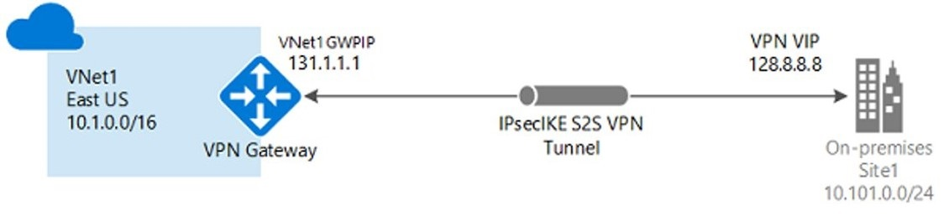
Plan a VPN Gateway
Site-to-site connections connect on-premises datacenters to Azure virtual networks
VNet-to-VNet connections connect Azure virtual networks to each other
Point-to-site (User VPN) connections connect individual devices to Azure virtual networks
Notes:
What is VPN Gateway? - https://docs.microsoft.com/Azure/vpn-gateway/vpn-gateway-about-vpngateways
When you're planning a VPN gateway, there are three architectures to consider:
Point to site over the internet
Site to site over the internet
Site to site over a dedicated network, such as Azure ExpressRoute
Factors that you need to cover during your planning process include:
Throughput - Mbps or Gbps
Backbone - Internet or private?
Availability of a public (static) IP address
VPN device compatibility
Multiple client connections or a site-to-site link?
VPN gateway type
Azure VPN Gateway SKU

Slide 6

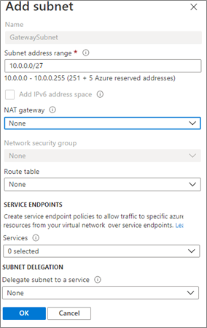
Create the Gateway Subnet
The gateway subnet contains the IP addresses; if possible, use a CIDR block of /28 or /27
When you create your gateway subnet, gateway VMs are deployed to the gateway subnet and configured with the required VPN gateway settings
Never deploy other resources (for example, additional VMs) to the gateway subnet
Notes:
Before the gateway can be deployed the GatewaySubnet must be created

Slide 7
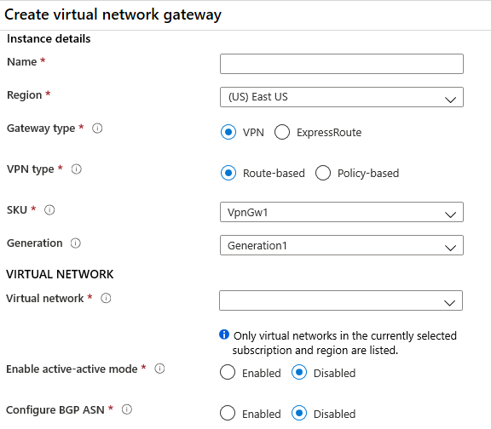

VPN Gateway Configuration requirements
Most VPN types are Route-based
Your choice of gateway SKU affects the number of connections you can have and the aggregate throughput benchmark
Associate a virtual network that includes the gateway subnet
The gateway needs a public IP address
It can take up to 45 minutes to provision the VPN gateway
Notes:
Route-based VPNs use routes in the IP forwarding or routing table to direct packets:
Support for IKEv2
Can use dynamic routing protocols
Policy-based VPNs encrypt and direct packets through IPsec tunnels based on the IPsec policies:
Support for IKEv1 only
Legacy on-premises VPN devices

Slide 8
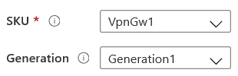
Choose the appropriate Gateway SKU and Generation
Sampling of available SKUs
Gen | SKU | S2S/VNet-to-VNet Tunnels | P2S IKEv2 Connections | Throughput Benchmark
1 | VpnGw1Az | Max. 30 | Max. 250 | 650 Mbps
1 | VpnGw2Az | Max. 30 | Max. 500 | 1.0 Gbps
2 | VpnGw2Az | Max. 30 | Max. 500 | 1.25 Gbps
1 | VpnGw3Az | Max. 30 | Max. 1000 | 1.25 Gbps
2 | VpnGw3Az | Max. 30 | Max. 1000 | 2.5 Gbps
2 | VpnGw4Az | Max. 30 | Max. 5000 | 5.0 Gbps
The Gateway SKU affects the connections and the throughput
Resizing is allowed within the generation
The Basic SKU (not shown) is legacy and should not be used
Notes:
About VPN Gateway configuration settings - https://docs.microsoft.com/Azure/vpn-gateway/vpn-gateway-about-vpn-gateway-settings
This table is just a sample of the SKUs that are available. There are many more.

Slide 9
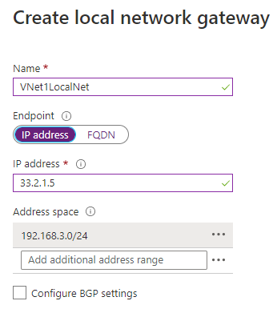
Create the Local Network Gateway
Reflects the on-premises network configuration and enables Azure to route to your on-premises network
Give the site a name by which Azure can refer to it
Use a public IP address or FQDN for Local Network Gateway Endpoint
Specify the IP address prefixes that will be routed through the gateway to the VPN device
Notes:
Tutorial - Connect an on-premises network and a virtual network: S2S VPN: Azure portal - Azure VPN Gateway | Microsoft Docs
https://docs.microsoft.com/Azure/vpn-gateway/tutorial-site-to-site-portal#LocalNetworkGateway
Configure BGP for VPN Gateway: Portal - Azure VPN Gateway | Microsoft Docs
https://docs.microsoft.com/Azure/vpn-gateway/bgp-howto
About BGP with VPN Gateway - Azure VPN Gateway | Microsoft Docs
https://docs.microsoft.com/Azure/vpn-gateway/vpn-gateway-bgp-overview

Slide 10
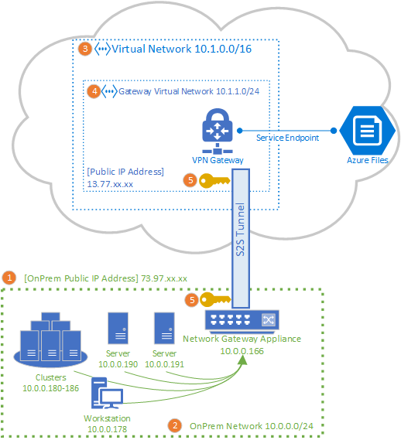
Configure the On-premises VPN Device
Remember the shared key for the Azure connection (next step)
Consult the list of supported VPN devices (Cisco, Juniper, Ubiquiti, Barracuda Networks)
Specify the public IP address (previous step)
A VPN device configuration script may be available
Notes:
About VPN devices and IPsec/IKE parameters for Site-to-Site VPN Gateway connections - https://docs.microsoft.com/en-us/Azure/vpn-gateway/vpn-gateway-about-vpn-devices

Slide 11
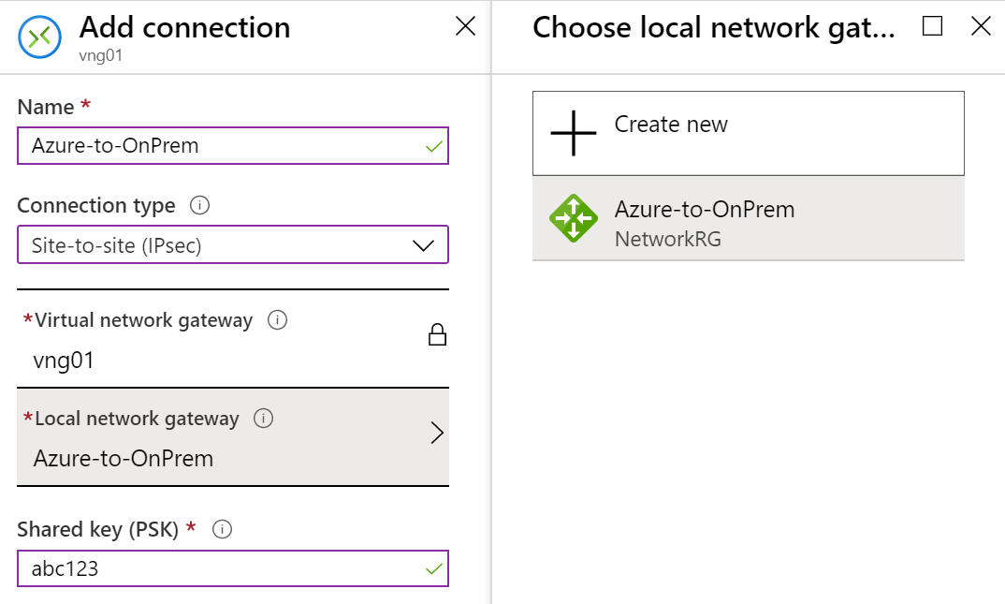
Create the VPN Connection
Once your VPN gateways is created and the on-premises device is configured, create a connection object
Configure a name for the connection and specify the type as Site-to-site (IPsec)
Select the VPN gateway and the Local Network Gateway
Enter the Pre-Shared key for the connection

Slide 12
Verify and troubleshoot the VPN connection
Validate VPN throughput to a VNet
Utilize Network Watcher
Troubleshoot Azure VPN Gateway using diagnostic logs
Check UDR and NSGs on the gateway subnet
Check whether the on-premises VPN device is validated
Verify the Azure gateway health probe
Verify the shared key and the VPN peer IPs
Check whether the on-premises VPN device has the perfect forward secrecy feature enabled
Notes:
Network watcher
VPN Gateway connections can fail for a variety of reasons. Although a network engineer will be able to troubleshoot many connectivity issues from experience, the following Microsoft documentation provides help and guidance for resolving many common problems.
Validate VPN throughput to a VNet
A VPN gateway connection enables you to establish secure, cross-premises connectivity between your Virtual Network within Azure and your on-premises IT infrastructure. This article shows how to validate network throughput from the on-premises resources to an Azure virtual machine (VM). It also provides troubleshooting guidance. https://docs.microsoft.com/azure/vpn-gateway/vpn-gateway-validate-throughput-to-vnet
Point-to-Site connections
This article lists common point-to-site connection problems that you might experience. It also discusses possible causes and solutions for these problems. See https://docs.microsoft.com/azure/vpn-gateway/vpn-gateway-troubleshoot-vpn-point-to-site-connection-problems
Site-to-Site connections
After you configure a site-to-site VPN connection between an on-premises network and an Azure virtual network, the VPN connection suddenly stops working and cannot be reconnected. This article provides troubleshooting steps to help you resolve this problem. See https://docs.microsoft.com/azure/vpn-gateway/vpn-gateway-troubleshoot-site-to-site-cannot-connect
VPN and Firewall device settings
This article provides several suggested solutions for third-party VPN or firewall devices that are used with VPN Gateway. Technical support for third-party VPN or firewall devices is provided by the device vendor. See https://docs.microsoft.com/azure/vpn-gateway/vpn-gateway-third-party-settings
Troubleshoot Azure VPN Gateway using diagnostic logs
Using diagnostic logs, you can troubleshoot multiple VPN gateway related events including configuration activity, VPN Tunnel connectivity, IPsec logging, BGP route exchanges, Point to Site advanced logging.
There are several diagnostic logs you can use to help troubleshoot a problem with your VPN Gateway.
GatewayDiagnosticLog - Contains diagnostic logs for gateway configuration events, primary changes, and maintenance events.
TunnelDiagnosticLog - Contains tunnel state change events. Tunnel connect/disconnect events have a summarized reason for the state change if applicable.
RouteDiagnosticLog - Logs changes to static routes and BGP events that occur on the gateway.
IKEDiagnosticLog - Logs IKE control messages and events on the gateway.
P2SDiagnosticLog - Logs point-to-site control messages and events on the gateway.
Use Azure Monitor to analyze the data collected in the diagnostic logs.

Slide 13
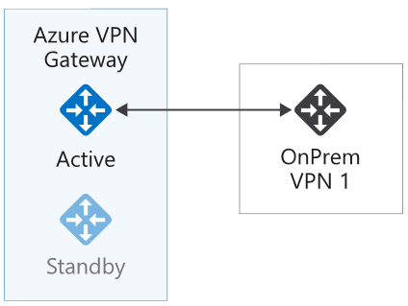
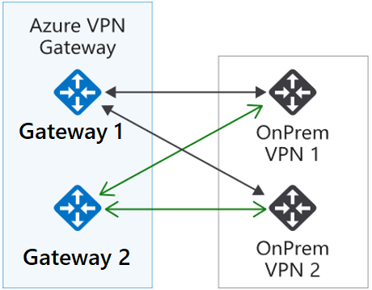
High availability options for VPN connections
Active/standby (default)
Active/active
VPN gateways are deployed as two instances
Enable active/active mode for higher availability
Notes:
Azure VPN Gateway topologies and design | Microsoft Docs https://docs.microsoft.com/azure/vpn-gateway/design
Configure active-active S2S VPN connections - Azure VPN Gateway | Microsoft Docs https://docs.microsoft.com/azure/vpn-gateway/vpn-gateway-activeactive-rm-powershell
https://docs.microsoft.com/azure/vpn-gateway/vpn-gateway-highlyavailable
To provide better availability for your VPN connections, there are a few options available:
VPN Gateway redundancy (Active-standby)
Multiple on-premises VPN devices
Active-active Azure VPN gateway
Combination of both

Slide 14
Demonstration – VPN gateways
Explore the Gateway subnet blade
Explore the Connected Devices blade
Explore adding a virtual network gateway
Explore adding a connection between the virtual networks
Notes:
✔ Always consider having students walk-through the demonstrations themselves. Also, consider the overlap with the formal labs and your best use of time.
In this demonstration, we will explore virtual network gateways.
Note: This demonstration works best with two virtual networks with subnets.
Explore the Gateway subnet blade
For one of your virtual networks, select the Subnets blade.
Select + Gateway subnet. Notice the name of the subnet cannot be changed. Notice the address range of the gateway subnet. The address must be contained by the address space of the virtual network.
Remember each virtual network needs a gateway subnet.
Close the Add gateway subnet page. You do not need to save your changes.
Explore the Connected Devices blade
For the virtual network, select the Connected Devices blade.
After a gateway subnet is deployed it will appear on the list of connected devices.
Explore adding a virtual network gateway
Search for Virtual network gateways.
Click + Add.
Review each setting for the virtual network gateway.
Use the Information icons to learn more about the settings.
Notice the Gateway type, VPN type, and SKU.
Notice the need for a Public IP address.
Remember each virtual network will need a virtual network gateway.
Close the Add virtual network gateway. You do not need to save your changes.
Explore adding a connection between the virtual networks
Search for Connections.
Click + Add.
Notice the Connection type can be VNet-to-VNet, Site-to-Site (IPsec), or ExpressRoute.
Provide enough information, so you can click the Ok button.
On the Settings page, notice that you will need to select the two different virtual networks.
Read the Help information on the Establish bidirectional connectivity checkbox.
Notice the Shared key (PSK) information.
Close the Add connection page. You do not need to save your changes.

Slide 15
Summary – Design and implement Azure VPN Gateway
Check your knowledge
Microsoft Learn Modules (docs.microsoft.com/Learn)
VPN Gateway documentation | Microsoft Docs
About Azure VPN Gateway | Microsoft Docs

Slide 16
Lesson 02: Exercise - Create and configure a Virtual Network Gateway

Slide 17
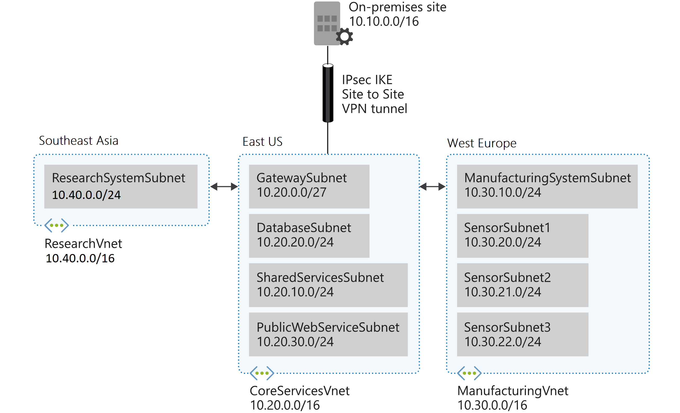
Exercise –Create and configure a virtual network gateway
Configure a virtual network gateway to connect the Contoso Core Services VNet and Manufacturing VNet
Notes:
AZ-700-Designing-and-Implementing-Microsoft-Azure-Networking-Solutions/3-exercise-create-configure-virtual-network-gateway.md at master · MicrosoftLearning/AZ-700-Designing-and-Implementing-Microsoft-Azure-Networking-Solutions (github.com)
https://microsoftlearning.github.io/AZ-700-Designing-and-Implementing-Microsoft-Azure-Networking-Solutions/Instructions/Exercises/M02-Unit%203%20Create%20and%20configure%20a%20virtual%20network%20gateway.html
This exercise deploys VPN gateway which will take 20min each
Have the students get to task 7 and then take a break while the gateways deploy

Slide 18
Lesson 03: Connect Networks with Site-to-site VPN Connections

Slide 19
Connect Networks with Site-to-site VPN Connections overview
Site-to-site VPN Connections
Review

Slide 20
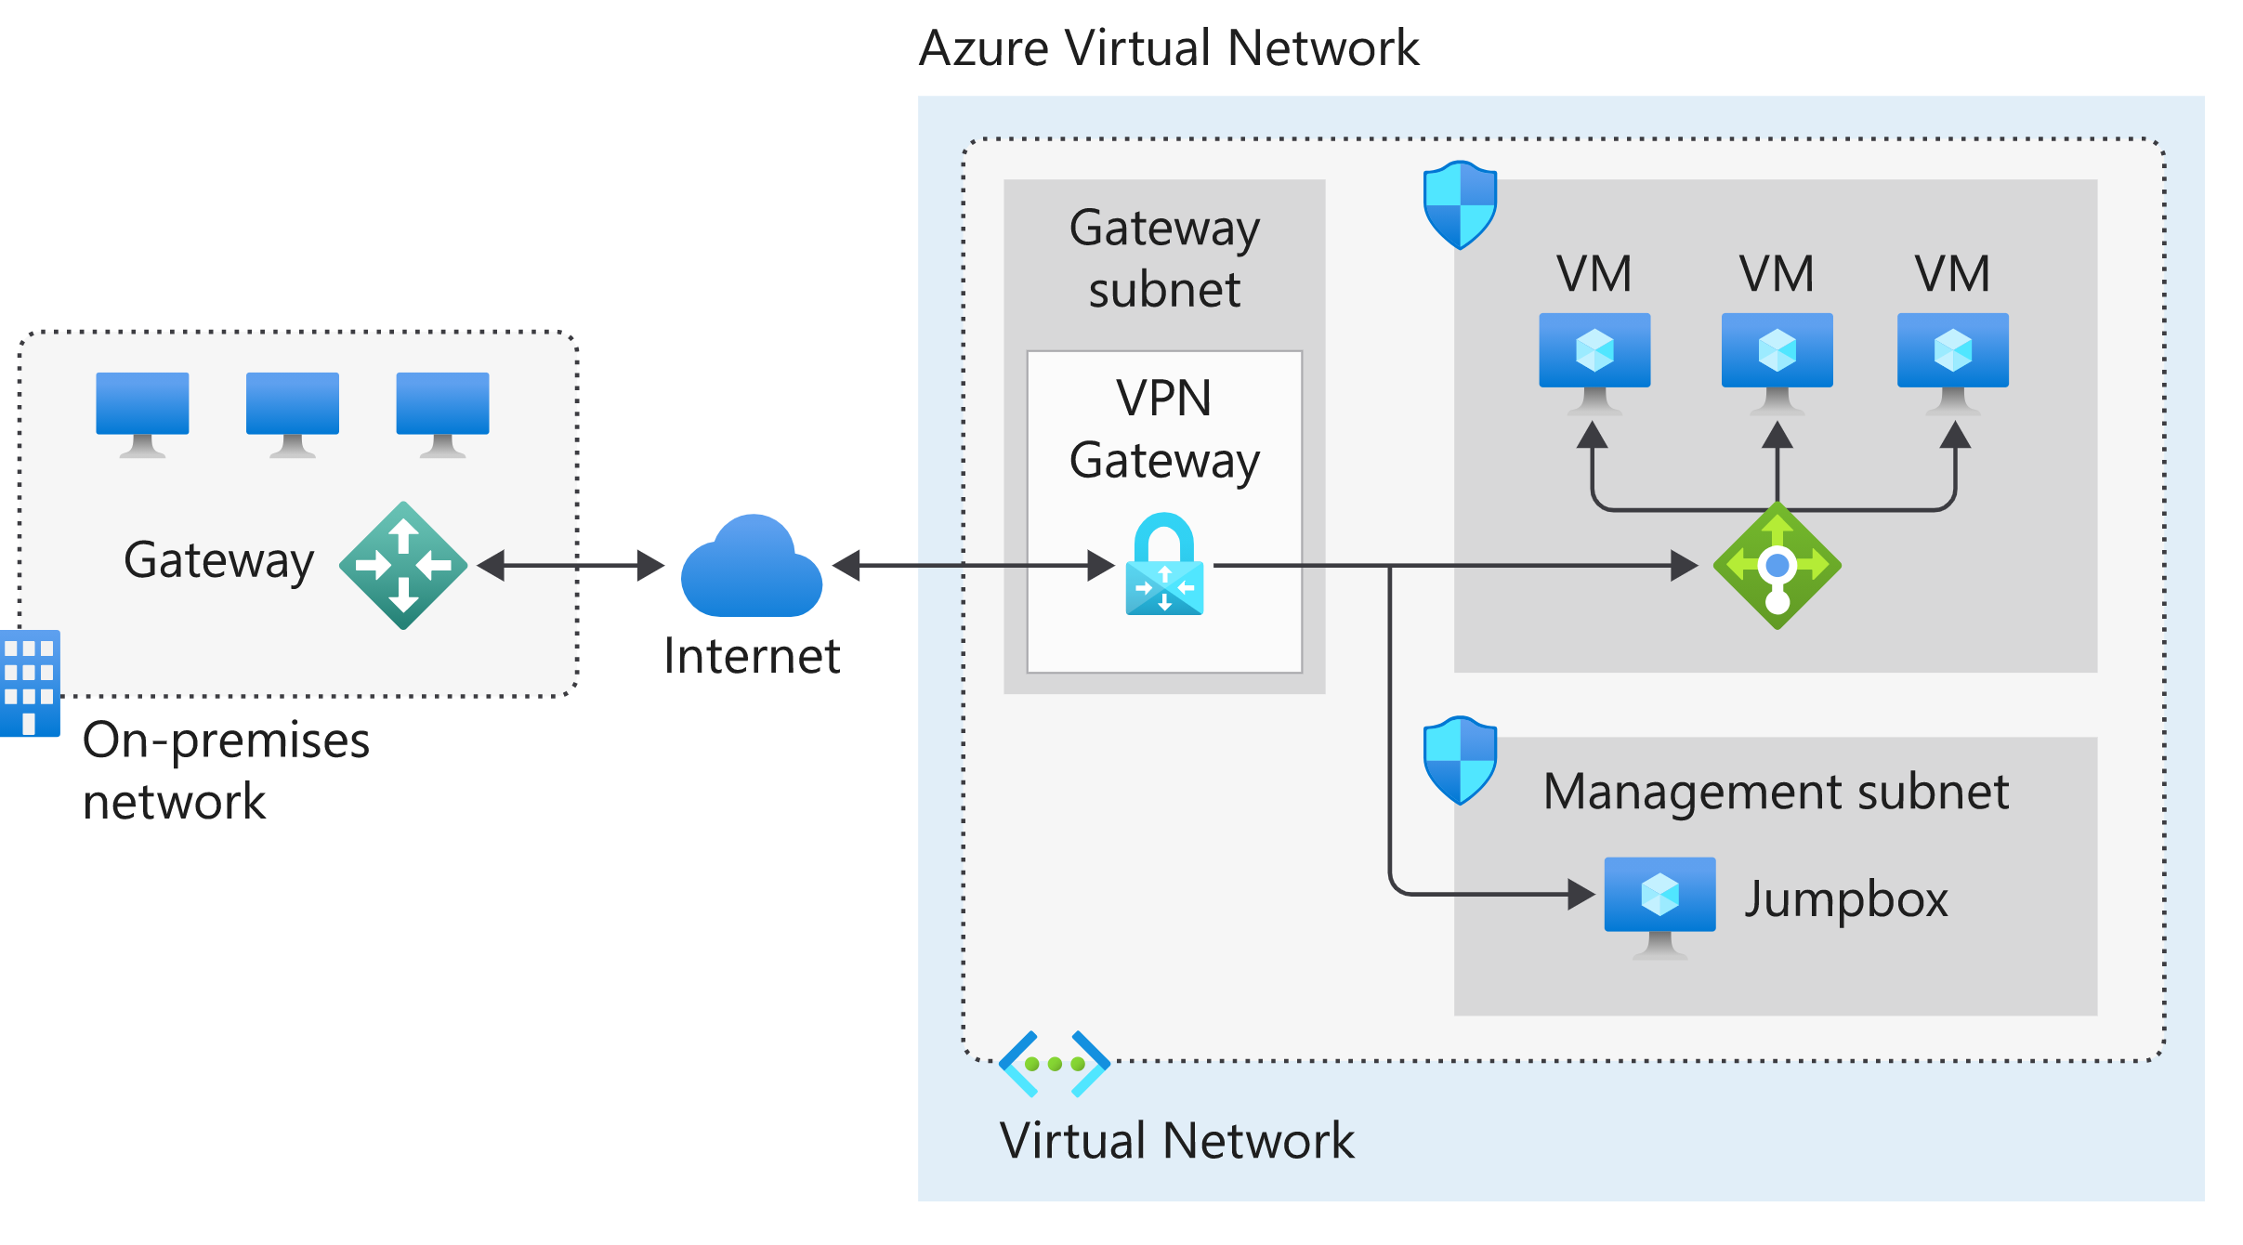
Site-to-site VPN connections
Notes:
https://azure.microsoft.com/blog/vnet-peering-and-vpn-gateways/
Choosing between Azure VNet Peering and VNet Gateways | Azure Blog and Updates | Microsoft Azure
Consider reviewing the S2S diagram in reference to what the student just created in the previous lesson before moving on to P2S
In the diagram:
The on-premises network represents your on-premises Active Directory and any data or resources.
The gateway is responsible for sending encrypted traffic to a virtual IP address when it uses a public connection.
The Azure virtual network holds all your cloud applications and any Azure VPN gateway components.
An Azure VPN gateway provides the encrypted link between the Azure virtual network and your on-premises network. An Azure VPN gateway is made up of these elements:
Virtual network gateway
Local network gateway
Connection
Gateway subnet
Cloud applications are the ones you've made available through Azure.
An internal load balancer, located in the front end, routes cloud traffic to the correct cloud-based application or resource.
Using this architecture offers several benefits, including:
Configuration and maintenance are simplified.
Having a VPN gateway helps ensure that all data and traffic are encrypted between the on-premises gateway and the Azure gateway.
The architecture can be scaled and extended to meet your organization's networking needs.
This architecture isn't applicable in all situations because it uses an existing internet connection as the link between the two gateway points. Bandwidth constraints can cause latency issues that result from reuse of the existing infrastructure.

Slide 21
Summary – Site-to-Site VPN Connections
Check your knowledge
Microsoft Learn Modules (docs.microsoft.com/Learn)
Tutorial - Connect on-premises network to virtual network: Azure portal - Azure VPN Gateway | Microsoft Docs
C

Slide 22
Lesson 04: Connect devices to networks with Point-to-site VPN connections

Slide 23
Connect devices to networks with Point-to-site VPN connections overview
Point-to-site protocols
Point-to-site authentication methods
Configure Point-to-site clients
Review

Slide 24
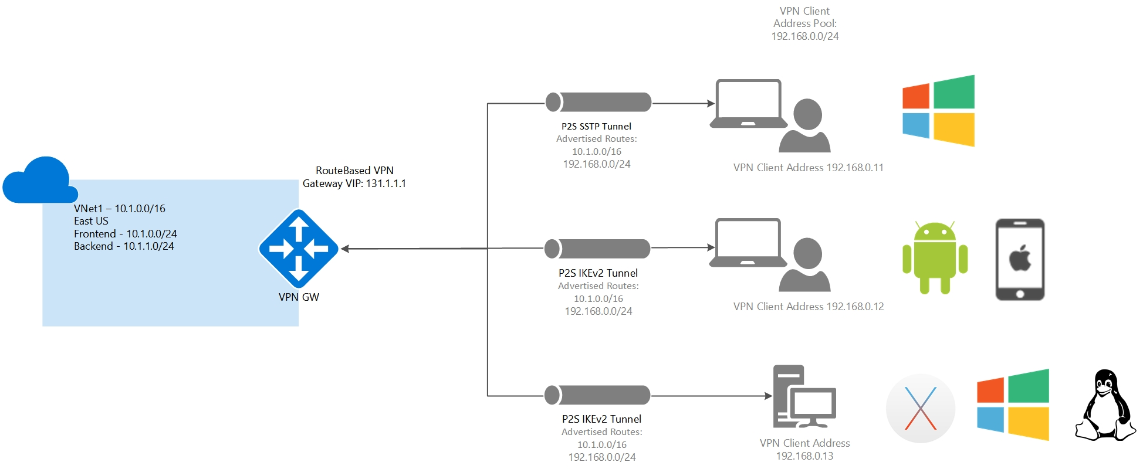
Point-to-site protocols
OpenVPN® Protocol
Secure Socket Tunneling Protocol (SSTP)
IKEv2 VPN
Notes:
Point-to-site VPN can use one of the following protocols:
OpenVPN® Protocol, an SSL/TLS based VPN protocol. A TLS VPN solution can penetrate firewalls, since most firewalls open TCP port 443 outbound, which TLS uses. OpenVPN can be used to connect from Android, iOS (versions 11.0 and above), Windows, Linux, and Mac devices (macOS versions 10.13 and above).
Secure Socket Tunneling Protocol (SSTP), a proprietary TLS-based VPN protocol. A TLS VPN solution can penetrate firewalls, since most firewalls open TCP port 443 outbound, which TLS uses. SSTP is only supported on Windows devices. Azure supports all versions of Windows that have SSTP (Windows 7 and later).
IKEv2 VPN, a standards-based IPsec VPN solution. IKEv2 VPN can be used to connect from Mac devices (macOS versions 10.11 and above).

Slide 25
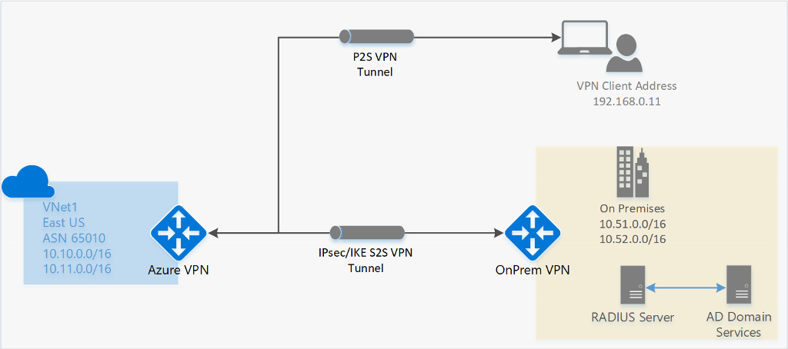
Point-to-site authentication methods
Azure certificate authentication
Native Azure Active Directory authentication
Active Directory (AD) Domain Server
Notes:
https://docs.microsoft.com/azure/vpn-gateway/point-to-site-about#authentication
Authenticate using native Azure certificate authentication
When using the native Azure certificate authentication, a client certificate on the device is used to authenticate the connecting user. Client certificates are generated from a trusted root certificate and then installed on each client computer. You can use a root certificate that was generated using an Enterprise solution, or you can generate a self-signed certificate.
The validation of the client certificate is performed by the VPN gateway and happens during establishment of the P2S VPN connection. The root certificate is required for the validation and must be uploaded to Azure.
Authenticate using native Azure Active Directory authentication
Azure AD authentication allows users to connect to Azure using their Azure Active Directory credentials. Native Azure AD authentication is only supported for OpenVPN protocol and Windows 10 and requires the use of the Azure VPN Client.
With native Azure AD authentication, you can leverage Azure AD's conditional access as well as Multi-Factor Authentication (MFA) features for VPN.
At a high level, you need to perform the following steps to configure Azure AD authentication:
Configure an Azure AD tenant
Enable Azure AD authentication on the gateway
Download and configure Azure VPN Client
Authenticate using Active Directory (AD) Domain Server
AD Domain authentication is a popular option because it allows users to connect to Azure using their organization domain credentials. It requires a RADIUS server that integrates with the AD server. Organizations can also leverage their existing RADIUS deployment.
The RADIUS server is deployed either on-premises or in your Azure VNet. During authentication, the Azure VPN Gateway passes authentication messages back and forth between the RADIUS server and the connecting device. Thus, the Gateway must be able to communicate with the RADIUS server. If the RADIUS server is present on-premises, then a VPN S2S connection from Azure to the on-premises site is required for reachability.
The RADIUS server can also integrate with AD certificate services. This lets you use the RADIUS server and your enterprise certificate deployment for P2S certificate authentication as an alternative to the Azure certificate authentication. Integrating the RADIUS server with AD certificate services means that you can do all your certificate management in AD, you don’t need to upload root certificates and revoked certificates to Azure.
A RADIUS server can also integrate with other external identity systems. This opens many authentication options for P2S VPN, including multi-factor options.

Slide 26
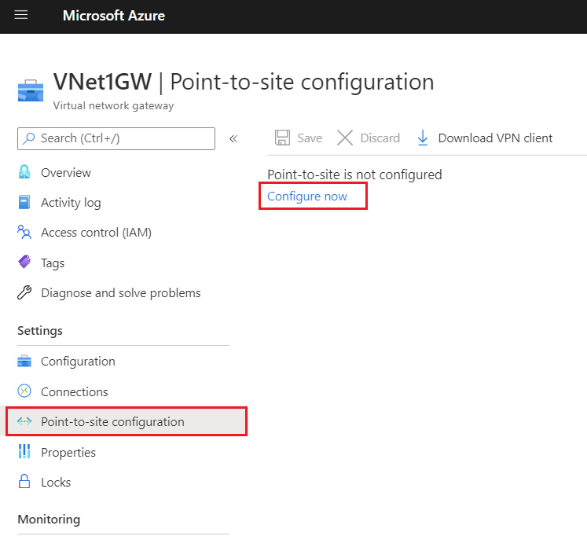
Prepare Point-to-site configuration in Azure
Navigate to the Settings section of the virtual network gateway page
Select Point-to-site configuration. Select Configure now to open the configuration page
On the Point-to-site configuration page, in the Address pool box, add the private IP address range that you want to use
VPN clients dynamically receive an IP address from the range that you specify. The minimum subnet mask is 29 bit for active/passive and 28 bit for active/active configuration.
Notes:
Users use the native VPN clients on Windows and Mac devices for P2S. Azure provides a VPN client configuration zip file that contains settings required by these native clients to connect to Azure.
For Windows devices, the VPN client configuration consists of an installer package that users install on their devices.
For Mac devices, it consists of the mobileconfig file that users install on their devices.
The zip file also provides the values of some of the important settings on the Azure side that you can use to create your own profile for these devices. Some of the values include the VPN gateway address, configured tunnel types, routes, and the root certificate for gateway validation.
Note that for Windows clients, you must have administrator rights on the client device to initiate the VPN connection from the client device to Azure.

Slide 27
Summary – Point-to-Site VPN Connections
Check your knowledge
Microsoft Learn Modules (docs.microsoft.com/Learn)
Connect to a VNet using P2S VPN & certificate authentication: portal - Azure VPN Gateway | Microsoft Docs
Configure an Always-On VPN tunnel - Azure VPN Gateway | Microsoft Docs

Slide 28
Lesson 05: Connect remote resources by using Azure Virtual WANs

Slide 29
Connect remote resources by using Azure Virtual WANs overview
What is Azure Virtual WAN?
Choose a Virtual WAN SKU
Hub private address space
Connect cross-tenant VNets to a virtual WAN hub
Virtual Hub routing
Demonstration
Review

Slide 30
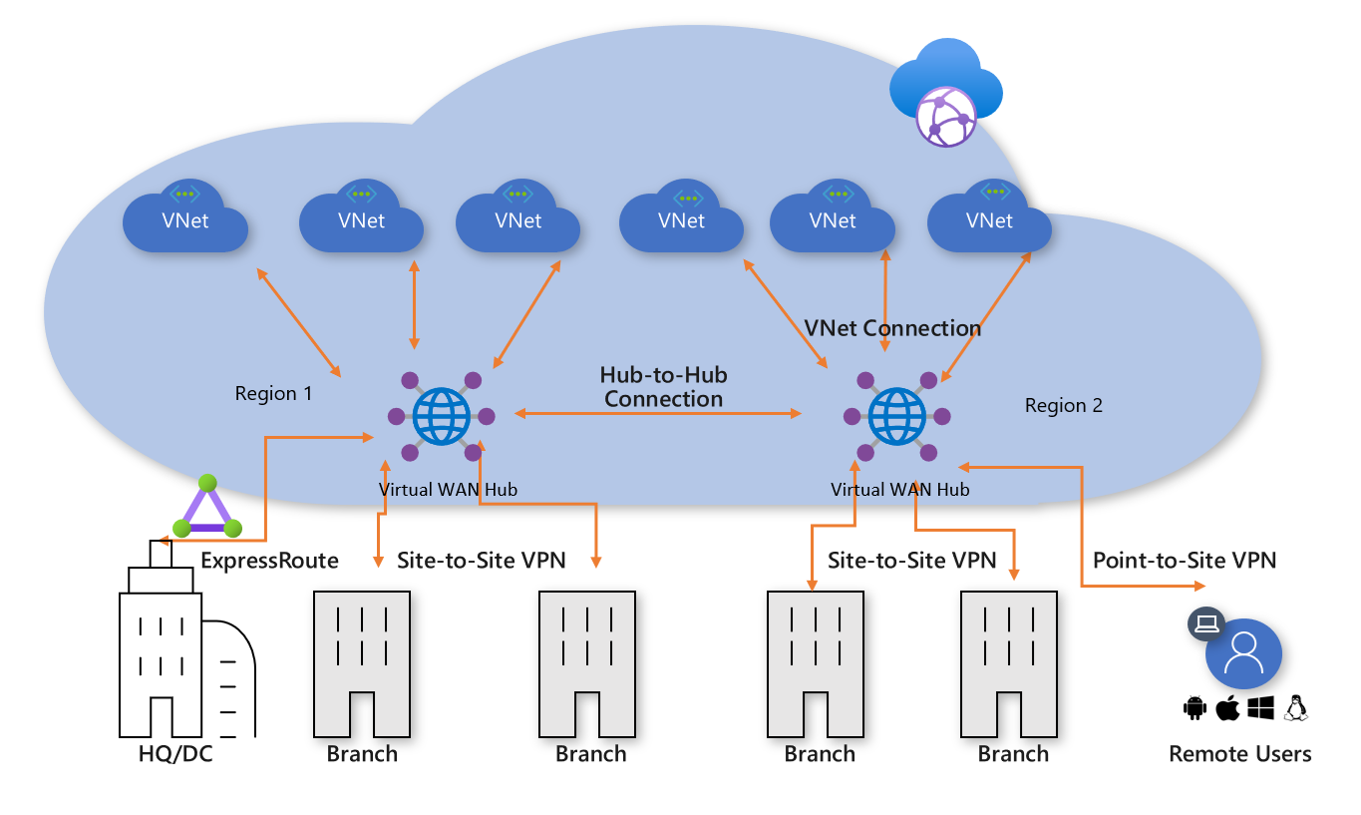
What is Azure Virtual WAN?
Brings together S2S, P2S, and ExpressRoute
Integrated connectivity using a hub-and-spoke connectivity model
Connect virtual networks and workloads to the Azure hub automatically
Visualize the end-to-end flow within Azure
Two types: Basic and Standard
Notes:
About Azure Virtual WAN - https://docs.microsoft.com/en-us/Azure/virtual-wan/virtual-wan-about
A virtual network gateway VPN is limited to 30 tunnels. For connections, you should use Virtual WAN for large-scale VPN. You can connect up to 1,000 branch connections per region (virtual hub) with aggregate of 20 Gbps per hub. A connection is an active-active tunnel from the on-premises VPN device to the virtual hub. You can have one hub per region, which means you can connect more than 1,000 branches across hubs.
Tutorial: Create a Site-to-Site connection using Azure Virtual WAN - https://docs.microsoft.com/en-us/Azure/virtual-wan/virtual-wan-site-to-site-portal
The following diagram shows an organization with a single Virtual WAN hub connecting the spokes. VNets, Site-to-site and point-to-site VPNs, SD WANs, and ExpressRoute connectivity are all supported .

Slide 31
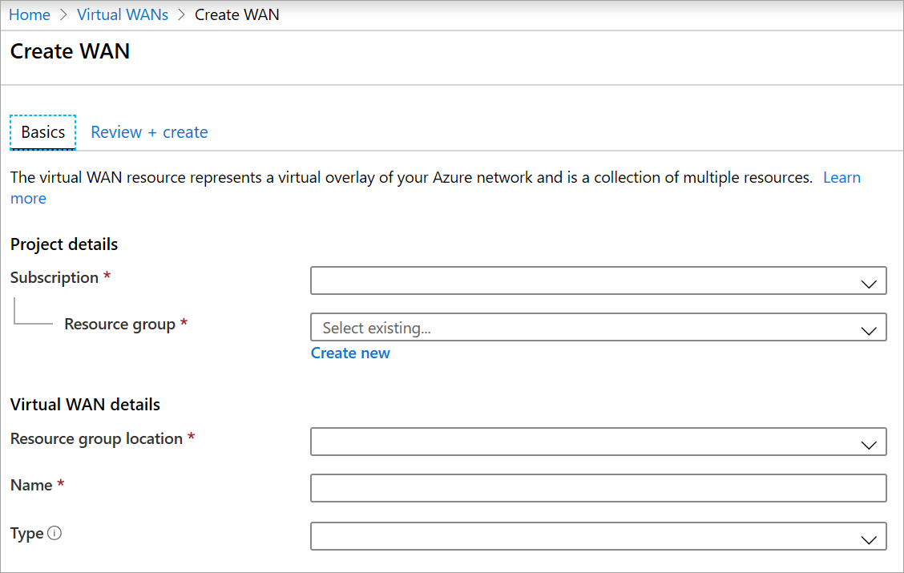
Choose Virtual WAN SKU
Virtual WAN type | Hub type | Available configuration
Basic | Basic | Site-to-site VPN only
Standard | Standard | ExpressRoute User VPN (P2S) VPN (Site-to-site) Inter-hub and VNet-to-VNet transiting through the virtual hub
Notes:
Subscription - Select the subscription that you want to use.
Resource group - Create new or use existing.
Resource group location - Choose a resource location from the dropdown. A WAN is a global resource and does not live in a particular region. However, you must select a region in order to manage and locate the WAN resource that you create.
Name - Type the Name that you want to call your WAN.
Type - Basic or Standard. Select Standard. If you select Basic VWAN, understand that Basic VWANs can only contain Basic hubs, which limits your connection type to site-to-site.

Slide 32
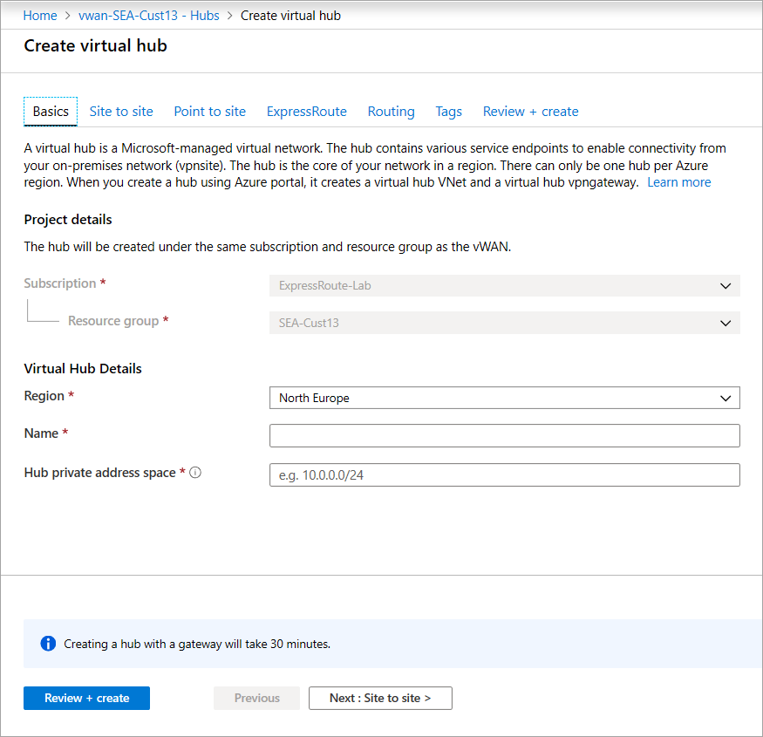
Hub private address space
Minimum address space is /24 to create a hub
No need to explicitly plan the subnet address space for the services in the virtual hub
Azure Virtual WAN is a managed service, it creates the appropriate subnets in the virtual hub for the different gateways/services
For example, VPN gateways, ExpressRoute gateways, User VPN Point-to-site gateways, Firewall, routing, etc.
Notes:
On the Create virtual hub page Basics tab, complete the following fields:
Project details
Region (previously referred to as Location)
Name
Hub private address space. The minimum address space is /24 to create a hub, which implies anything range from /25 to /32 will produce an error during creation. Azure Virtual WAN, being a managed service by Microsoft, creates the appropriate subnets in the virtual hub for the different gateways/services. (For example: Network Virtual Appliances, VPN gateways, ExpressRoute gateways, User VPN/Point-to-site gateways, Firewall, Routing, etc.). There is no need for the user to explicitly plan for subnet address space for the services in the Virtual hub because Microsoft does this as a part of the service.

Slide 33
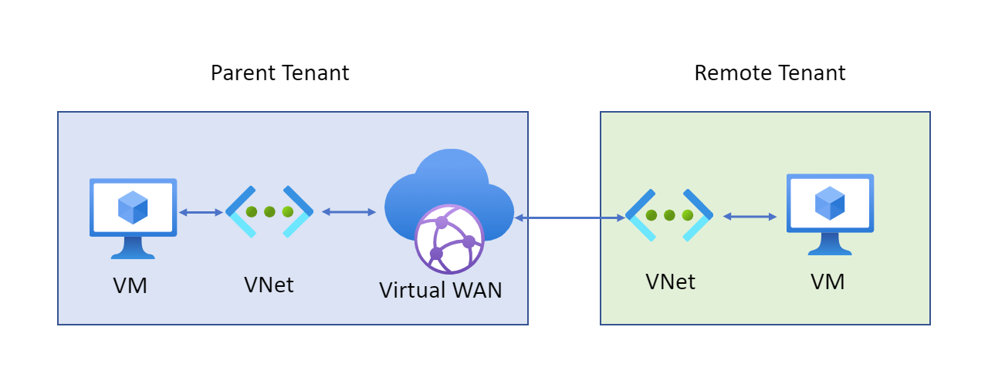
Connect cross-tenant VNets to a Virtual WAN hub
A Virtual WAN and virtual hub in the parent subscription
A virtual network configured in a subscription in the remote tenant
Non-overlapping address spaces in the remote tenant and address spaces within any other VNets already connected to the parent virtual hub
Notes:
You can use Virtual WAN to connect a VNet to a virtual hub in a different tenant. This architecture is useful if you have client workloads that must be connected to be the same network but are on different tenants. For example, as shown in the following diagram, you can connect a non-Contoso VNet (the Remote Tenant) to a Contoso virtual hub (the Parent Tenant).
Before you can connect a cross-tenant VNet to a Virtual WAN hub, you must have the following configuration already set up:
A Virtual WAN and virtual hub in the parent subscription.
A virtual network configured in a subscription in the remote tenant.
Non-overlapping address spaces in the remote tenant and address spaces within any other VNets already connected to the parent virtual hub.
For the parent subscription with the virtual hub to modify and access the virtual networks in the remote tenant, you need to assign Contributor permissions to your parent subscription from the remote tenant subscription.
Add the Contributor role assignment to the parent account (the one with the virtual WAN hub). You can use PowerShell or the Azure portal to assign this role.
Add the remote tenant subscription and the parent tenant subscription to the current session of PowerShell by running the Add-AzAccount command. If you are signed into the parent, you only need to run the command for the remote tenant.
Verify that the role assignment is successful by logging into Azure PowerShell using the parent credentials and running the Get-AzSubscription command. If the permissions have successfully propagated to the parent and have been added to the session, the output of the command will list the subscription owned by the remote tenant.

Slide 34
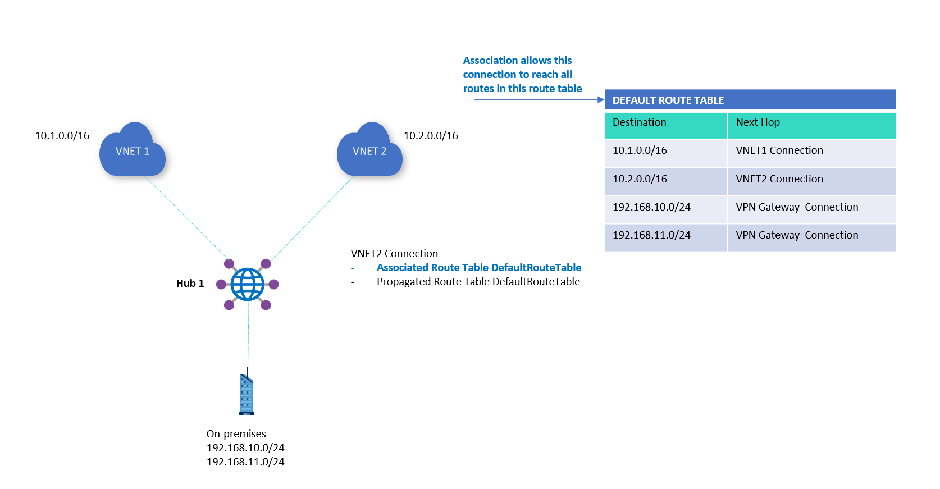
Virtual Hub Routing
Hub route table
Connections
Association
Propagation
Labels
Static routes
Notes:
The routing capabilities in a virtual hub are provided by a router that manages all routing between gateways using Border Gateway Protocol (BGP). A virtual hub can contain multiple gateways such as a Site-to-site VPN gateway, ExpressRoute gateway, Point-to-site gateway, Azure Firewall. This router also provides transit connectivity between virtual networks that connect to a virtual hub and can support up to an aggregate throughput of 50 Gbps. These routing capabilities apply to Standard Virtual WAN customers.
Hub route table
A virtual hub route table can contain one or more routes. A route includes its name, a label, a destination type, a list of destination prefixes, and next hop information for a packet to be routed. A Connection typically will have a routing configuration that associated or propagates to a route table.
Connections
Connections are Resource Manager resources that have a routing configuration. The four types of connections are:
VPN connection: Connects a VPN site to a virtual hub VPN gateway.
ExpressRoute connection: Connects an ExpressRoute circuit to a virtual hub ExpressRoute gateway.
P2S configuration connection: Connects a User VPN (Point-to-site) configuration to a virtual hub User VPN (Point-to-site) gateway.
Hub virtual network connection: Connects virtual networks to a virtual hub.
You can set up the routing configuration for a virtual network connection during setup. By default, all connections associate and propagate to the Default route table.
Association
Each connection is associated to one route table. Associating a connection to a route table allows the traffic to be sent to the destinations indicated as routes in the route table. The routing configuration of the connection will show the associated route table. Multiple connections can be associated to the same route table. All VPN, ExpressRoute, and User VPN connections are associated to the same (default) route table.
By default, all connections are associated to a Default route table in a virtual hub. Each virtual hub has its own Default route table, which can be edited to add a static route(s). Routes added statically take precedence over dynamically learned routes for the same prefixes.

Slide 35
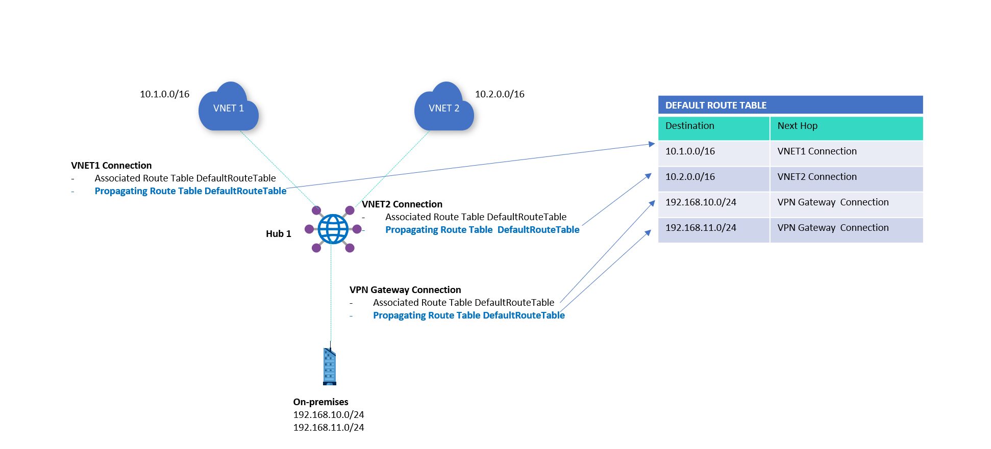
Virtual Hub Routing – continued
Notes:
Propagation - default routing table.

Slide 36
Demonstration – route to shared services using an ARM template
Review and deploy the ARM template
Complete the hybrid configuration
Notes:
Consider demonstrating this to the students:
Quickstart: Route to shared services using an ARM template - Azure Virtual WAN | Microsoft Docs
This quickstart describes how to use an Azure Resource Manager template (ARM template) to set up routes to access a shared service VNet with workloads that you want every VNet and Branch (VPN/ER/P2S) to access. Examples of these shared workloads might include virtual machines with services like domain controllers or file shares, or Azure services exposed internally through Azure Private Endpoint.
An ARM template is a JavaScript Object Notation (JSON) file that defines the infrastructure and configuration for your project. The template uses declarative syntax. In declarative syntax, you describe your intended deployment without writing the sequence of programming commands to create the deployment.
If your environment meets the prerequisites and you're familiar with using ARM templates, select the Deploy to Azure button. The template will open in the Azure portal.

Slide 37
Connect remote resources by using Azure Virtual WANs Review
Knowledge Check Questions
Microsoft Learn Modules (docs.microsoft.com/Learn)
Virtual WAN documentation | Microsoft Docs
Azure Virtual WAN Overview | Microsoft Docs
Notes:
Learn - https://docs.microsoft.com/en-us/learn/browse/

Slide 38
Lesson 06: Exercise: create a virtual WAN by using the Azure portal

Slide 39
Exercise – Create a Virtual WAN by using Azure Portal
Objectives
Task 1:
Create a Virtual WAN
Task 2:
Create a hub
Task 3:
Connect a VNet to the Virtual Hub
Notes:
AZ-700-Designing-and-Implementing-Microsoft-Azure-Networking-Solutions/7-exercise-create-virtual-wan-by-using-Azure-portal.md at master · MicrosoftLearning/AZ-700-Designing-and-Implementing-Microsoft-Azure-Networking-Solutions (github.com)
https://microsoftlearning.github.io/AZ-700-Designing-and-Implementing-Microsoft-Azure-Networking-Solutions/Instructions/Exercises/M02-Unit%207%20Create%20a%20Virtual%20WAN%20by%20using%20Azure%20Portal.html

Slide 40
Lesson 07: Create a network virtual appliance (NVA) in a virtual hub

Slide 41
Create a network virtual appliance (NVA) in a virtual hub overview
Manage an NVA in a Virtual Hub
Deploy an NVA in your Virtual Hub
Review

Slide 42
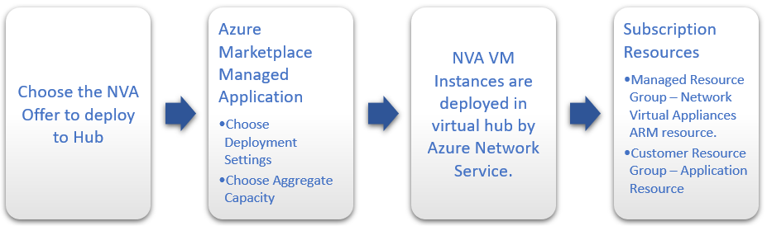
Manage an NVA in a Virtual Hub
Notes:
The NVAs available in the Azure marketplace are designed to be deployed directly into a virtual hub and nowhere else. Each is deployed as a Managed Application, which allows Azure Virtual WAN to manage the configuration of the NVA. They cannot be deployed within an arbitrary VNet.
The following diagram shows the NVA deployment process:

Slide 43
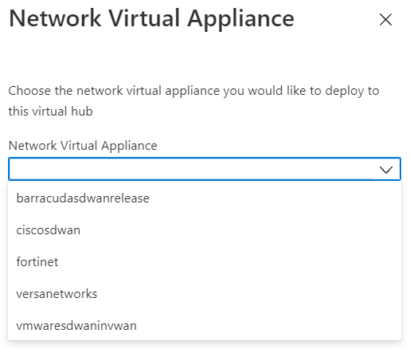
Deploy an NVA in your Virtual Hub
Locate the Virtual WAN hub you created in the previous step and open it
Find the Network Virtual Appliances tile and select the Create link.
On the Network Virtual Appliance blade, select your preferred provider based on available selections, then select the Create button
Notes:
Azure Virtual WAN: About Network Virtual Appliance in the hub | Microsoft Docs
At this time, only Barracuda CloudGen WAN, Cisco Cloud vWAN Application, and VMware Sd-WAN are available to be deployed into the Virtual WAN hub.
To deploy an NVA in your virtual hub, you can access the Azure Marketplace through the Azure Portal and select the Managed Application for the NVA partner that you need to enable connectivity for your devices. When you create an NVA in the Virtual WAN hub, like all Managed Applications, there will be two Resource Groups created in your subscription.
• Customer Resource Group - This will contain an application placeholder for the Managed Application. Partners can use this to expose whatever customer properties they choose here.
• Managed Resource Group - Customers cannot configure or change resources in this resource group directly, as this is controlled by the publisher of the Managed Application. This Resource Group will contain the NetworkVirtualAppliances resource.
The NVA is configured automatically as part of the deployment process. Once the NVA has been provisioned into the virtual hub, any additional configuration must be performed via the NVA partners portal or management application. You cannot access the NVA directly.
Unlike Azure VPN Gateway configurations, you do not need to create Site resources, Site-to-Site connection resources, or point-to-site connection resources to connect your branch sites to your NVA in the Virtual WAN hub. This is all managed via the NVA partner.
You still need to create Hub-to-VNet connections to connect your Virtual WAN hub to your Azure VNets.
NVA Infrastructure Units
When you create an NVA in the Virtual WAN hub, you must choose the number of NVA Infrastructure Units you want to deploy it with. An NVA Infrastructure Unit is a unit of aggregate bandwidth capacity for an NVA in the Virtual WAN hub. An NVA Infrastructure Unit is similar to a VPN Scale Unit in terms of the way you think about capacity and sizing.
• 1 NVA Infrastructure Unit represents 500 Mbps of aggregate bandwidth for all branch site connections coming into this NVA.
• Azure supports from 1-80 NVA Infrastructure Units for a given NVA virtual hub deployment.
• Each partner may offer different NVA Infrastructure Unit bundles that are a subset of all supported NVA Infrastructure Unit configurations.
To learn more about deploying an NVA, see How to create a Network Virtual Appliance in an Azure Virtual WAN hub (Preview).

Slide 44
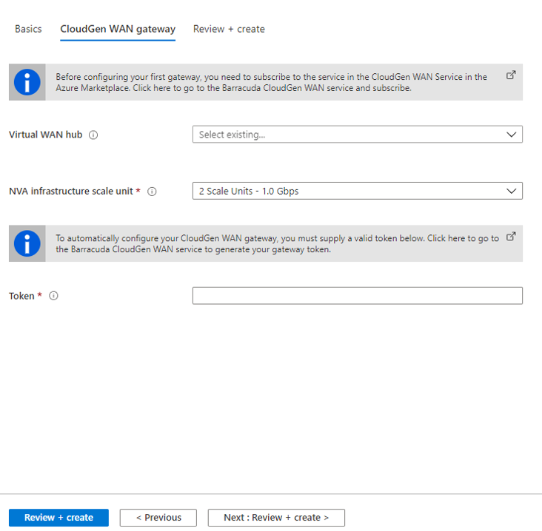
Deploy an NVA in your Virtual Hub Cont.
Virtual WAN Hub - The Virtual WAN hub you want to deploy this NVA into
NVA Infrastructure Units - Indicate the number of NVA Infrastructure Units you want to deploy this NVA with. Choose the amount of aggregate bandwidth capacity you want to provide across all the branch sites that will be connecting to this hub through this NVA.
Token - Barracuda requires that you provide an authentication token here in order to identify yourself as a registered user of this product. You'll need to obtain this from Barracuda.
Notes:
To deploy an NVA in your virtual hub, you can access the Azure Marketplace through the Azure Portal and select the Managed Application for the NVA partner that you need to enable connectivity for your devices. When you create an NVA in the Virtual WAN hub, like all Managed Applications, there will be two Resource Groups created in your subscription.
• Customer Resource Group - This will contain an application placeholder for the Managed Application. Partners can use this to expose whatever customer properties they choose here.
• Managed Resource Group - Customers cannot configure or change resources in this resource group directly, as this is controlled by the publisher of the Managed Application. This Resource Group will contain the NetworkVirtualAppliances resource.
The NVA is configured automatically as part of the deployment process. Once the NVA has been provisioned into the virtual hub, any additional configuration must be performed via the NVA partners portal or management application. You cannot access the NVA directly.
Unlike Azure VPN Gateway configurations, you do not need to create Site resources, Site-to-Site connection resources, or point-to-site connection resources to connect your branch sites to your NVA in the Virtual WAN hub. This is all managed via the NVA partner.
You still need to create Hub-to-VNet connections to connect your Virtual WAN hub to your Azure VNets.
NVA Infrastructure Units
When you create an NVA in the Virtual WAN hub, you must choose the number of NVA Infrastructure Units you want to deploy it with. An NVA Infrastructure Unit is a unit of aggregate bandwidth capacity for an NVA in the Virtual WAN hub. An NVA Infrastructure Unit is similar to a VPN Scale Unit in terms of the way you think about capacity and sizing.
• 1 NVA Infrastructure Unit represents 500 Mbps of aggregate bandwidth for all branch site connections coming into this NVA.
• Azure supports from 1-80 NVA Infrastructure Units for a given NVA virtual hub deployment.
• Each partner may offer different NVA Infrastructure Unit bundles that are a subset of all supported NVA Infrastructure Unit configurations.
To learn more about deploying an NVA, see How to create a Network Virtual Appliance in an Azure Virtual WAN hub (Preview).

Slide 45
Create a network virtual appliance (NVA) in a virtual hub - Review
Knowledge Check Questions
Microsoft Learn Modules (docs.microsoft.com/Learn)
Azure Virtual WAN: About Network Virtual Appliance in the hub | Microsoft Docs
What is a secured virtual hub? | Microsoft Docs
Notes:
Learn - https://docs.microsoft.com/en-us/learn/browse/

Slide 46
End of presentation

